Slide 1
FMEA Training

Slide 2
Purpose of the FMEA
Preventive costs
Cost of validation
Warranty costs
Identify and eliminate potential defects
Detection and correction of defects
Detection and correction EXTERNAL defects
Validation tests
D-FMEA
P-FMEA
Product development
Project planning
Pre-
production
Production
Lifetime
Manufacturer / supplier
Customer
Preventive costs to identify potential defects by FMEA’s are relatively low compared to in-house detection and correction of defects and even much lower than recovery costs in case defects are found by our Customers.
Page 2

Slide 3
FMEA
Purpose of the FMEA
Purpose of the FMEA:
Methodology that facilitates process improvement
Identifies and eliminates concerns early in the development of a process or design
Improve internal and external customer satisfaction
Risk Management tool, focuses on prevention
FMEA may be a customer requirement (likely contractual, Level 3 PPAP, ISO 9001)
Page 3

Slide 4
Learning FMEA, Training Objectives
Training Objectives:
To understand the use of Failure Modes and Effect Analysis(FMEA)
To learn the steps to developing FMEAs
To summarize the different types of FMEAs
To learn how to link the FMEA to other Process tools
Page 4

Slide 5
FMEA, Summary
FMEA, a mathematical way to identify:
failure modes, the ways in which a product or process can fail
the Effects and Severity of a failure mode
Potential causes of the failure mode
the Occurrence of a failure mode
the Detection of a failure mode
the level of risk (Risk Priority Number)
actions that should be taken to reduce the RPN
RPN = Severity X Occurrence X Detection
Page 5

Slide 6
Benefits
FMEA, Inputs
Inputs might include other tools such as:
D-FMEA (Part and Assembly level) Defines VOC
Customer requirements
CTQ Flow down analysis
Quality Function Deployment (House Of Quality)
Risk assessments
P-FMEA (Process level) Delivers VOC
Process flowchart
Sequence Of Events
Process Tooling
Poka-Yoke list
Page 6

Slide 7
FMEA, Application Examples
There are several situations where an FMEA is the optimal tool to identify risk:
Process-FMEA:
Introducing a new process
Reviewing existing processes after modifications
Introduce new Part Numbers on an existing Production Line
Design-FMEA:
Introducing a new Design, Part, Sub Assembly or Assembly
Use an existing Design for another application
Reviewing existing Designs after modifications
Page 7

Slide 8
What Is A Failure Mode?
A Failure Mode is:
The way in which the component, subassembly, product or process could fail to perform its intended function
Failure modes may be the result of previous operations or may cause next operations to fail
Things that could go wrong INTERNALLY:
Warehouse
Production Process
Things that could go wrong EXTERNALLY:
Supplier Location
Final Customer
Page 8

Slide 9
When to Conduct an FMEA
When to Conduct an FMEA?
Early in the New Product Introduction (A-Build) complete for B build.
When new systems, products, and processes are being designed
When existing designs or processes are being changed, FMEA’s to be updated
When process improvements are made due to Corrective Action Requests
Page 9

Slide 10
History of FMEA
History of FMEA:
First used in the 1960’s in the Aerospace industry during the Apollo missions
In 1974, the Navy developed MIL-STD-1629 regarding the use of FMEA
In the late 1970’s, the automotive industry was driven by liability costs to use FMEA
Later, the automotive industry saw the advantages of using this tool to reduce risks related to poor quality (QS-9000, VDA and ISO-TS 16949 standard)
Page 10

Slide 11
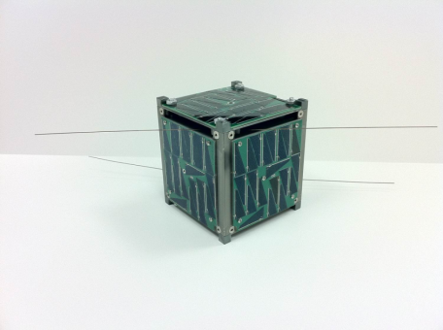
History of FMEA, Case Study
Case Study, what could have been avoided using FMEA
AubieSat-1 was the first ever, 4-inch Cube Satellite to be accepted by NASA for launch.
It was launched into space 28 th October 2011 from Vandenberg Air Force Base in California on a NASA-sponsored Delta II rocket.
Page 11

Slide 12
History of FMEA, Case Study
What was the failure mode?
Lessons learned:
Plan for errors!
The use of an FMEA most likely had avoided the malfunction involving people from the earlier flight
Teamwork!
The collaboration relationship between teams enabled the team to use the alternative equipment. Without it, the mission could have failed.
Once the satellite was deployed:
the team had problems making contact with the satellite
One of the 2 antennae failed to deploy
The signal transmitter at the control center did not have enough power to communicate with the satellite
How was it solved?
The team used another signal transmitter from an earlier flight which had enough power to enable communication
Why Do I Care?
First Time Right, Calculated Risk, Rights Team will safe resources!
Page 12

Slide 13
Types of FMEAs
Design FMEA
Analyzes product design before release to production, with a focus on product function
Analyzes systems and subsystems in early concept and design stages
Process FMEA
Used to analyze manufacturing and assembly processes before they are implemented
Page 13

Slide 14
FMEA: A Team Tool
A team approach is necessary, see example AubieSat-1
communication problems could have been avoided by involving a practical experienced team!
Team should be led by the Right person, Design, Manufacturing or Quality Engineer, etc…familiar with FMEA
The following Team members should be considered:
Design Engineers
Process Engineers
Supply Chain Engineers
Line Design Engineers
Suppliers
Operators
Practical Experts
Page 14

Slide 15
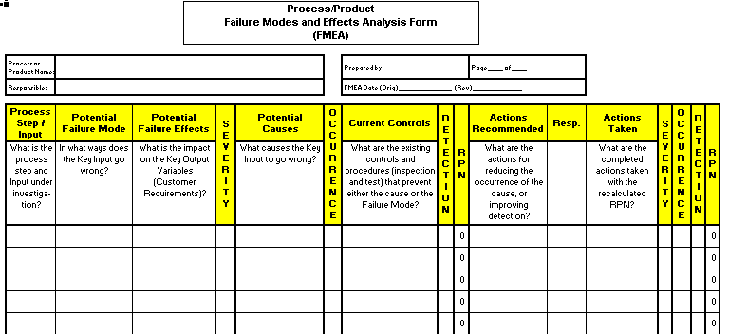
The FMEA Form
Identify failure modes and their effects
Identify causes of the failure modes
and controls
Prioritize
Determine and assess actions
Page 15

Slide 16
FMEA Procedure
For each process input determine the ways in which the input can go wrong (failure mode)
2. For each failure mode, determine effects
Select a Severity level for each effect
3. Identify potential causes of each failure mode
Select an Occurrence level for each cause
4. List current controls for each cause
Select a Detection level for each cause
RPN = Severity X Occurrence X Detection
Page 16

Slide 17
FMEA Procedure (Cont.)
5. Calculate the Risk Priority Number (RPN)
6. Develop recommended actions, assign responsible persons, and take actions
Give priority to high RPNs
MUST look at highest severity
7. Assign the predicted Severity, Occurrence, and Detection levels and compare RPNs (before and after risk reduction)
Page 17

Slide 18
Rating Scales
Preferred Scales are1-10
Adjust Occurence scales to reality figures for your company
Severity:
1 = Not Severe, 10 = Very Severe
Occurrence:
1 = Not Likely, 10 = Very Likely
Detection:
1 = Easy to Detect, 10 = Not easy to Detect
Page 18

Slide 19
The FMEA Form
A Closer Look
Identify failure modes and their effects
Identify causes of the failure modes
and controls
Prioritize
Determine and assess actions
Page 19

Slide 20
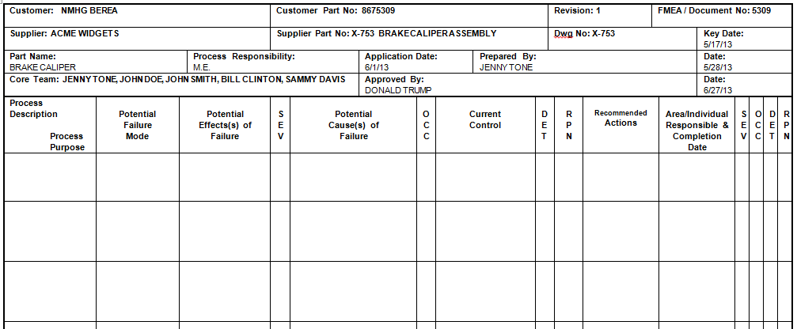
Risk Assessment with FMEA
Page 20
Notes:
Key point is “Team”. It’s not uncommon for a single person being responsible to update a document. When this occurs, we are not taking it seriously enough.

Slide 21
Risk Assessment with FMEA
Identify failure modes at each process step!
Identify consequences of that failure!
Determine Severity of failure mode!
Identify potential root causes of failure mode!
Potential for occurrence!
Document current process controls!
Risk Priority Number (RPN).
Highest # equals Highest Risk!
Severity x Occurrence x Detectability = RPN
Use Like Pareto Chart to identify what items to address first.
How capable are we of detecting the failure mode with our current controls?
Page 21
Notes:
Key point is “Team”. It’s not uncommon for a single person being responsible to update a document. When this occurs, we are not taking it seriously enough.

Slide 22
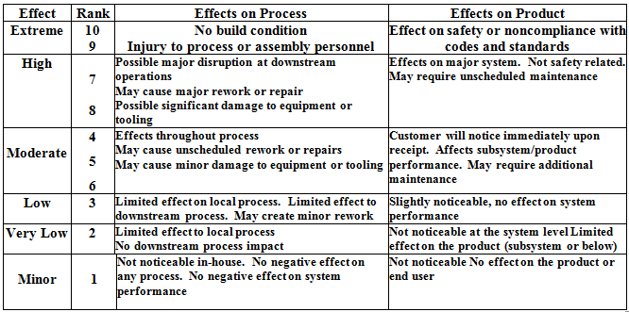
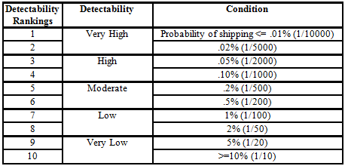
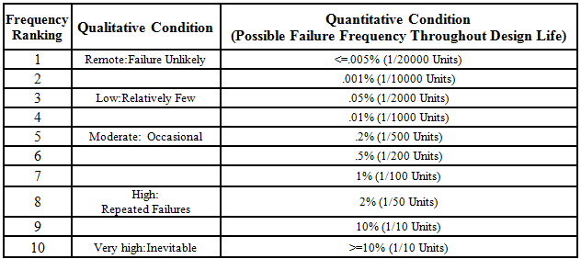
Risk Assessment with FMEA
Severity
Detection
Occurrence
Page 22
Notes:
Highlight some of the key differences such as the Extreme Severity (without warning = 10 & with warning =9)

Slide 23
Risk Assessment with FMEA
TORQUE WRENCH NOT CONTROLLED
DC TORQUE WRENCH USED / LINKED TO OMS
ADD TORQUE ALARM AND CALIBRATION AT START UP.
JENNY TONE
10
CASTING ATTACH TORQUE
CASTING FRACTURE
2
20
OVER TORQUE
10
4
3
120
1
UNDER TORQUE
CASTING SEPARATION
9
TORQUE WRENCH NOT USED/ CONTROLLED
CROSS THREAD
CASTING SEPARATION
9
NO LEAD IN ON BOLT THREAD
Page 23
Notes:
Without warning is the key explanation with a brake casting fracture. Need to explain that’s why we need further action as the occurrence is still present at 1 in 2000.

Slide 24
Risk Priority Number (RPN)
RPN is the product of the severity, occurrence, and detection scores
Severity
X
Occurrence
X
Detection
=
RPN
Page 24

Slide 25
FMEA, 10 Steps Checklist
10 Steps to Conduct a PFMEA
1
Review the process—Use a process flowchart to identify each process component
Brainstorm potential failure modes—Review existing documentation and data for clues
List potential effects of failure—There may be more than one for each failure
Assign Severity rankings—Based on the severity of the consequences of failure
Assign Occurrence rankings—Based on how frequently the cause of the failure is likely to occur
Assign Detection rankings—Based on the chances the failure will be detected prior to the customer finding it
Calculate the RPN—Severity X Occurrence X Detection
Develop the action plan—Define who will do what by when
Take action—Implement the improvements identified by your PFMEA team
Calculate the resulting RPN—Re-evaluate each of the potential failures once improvements have been made and determine the impact of the improvements
Page 25

